Slide 1

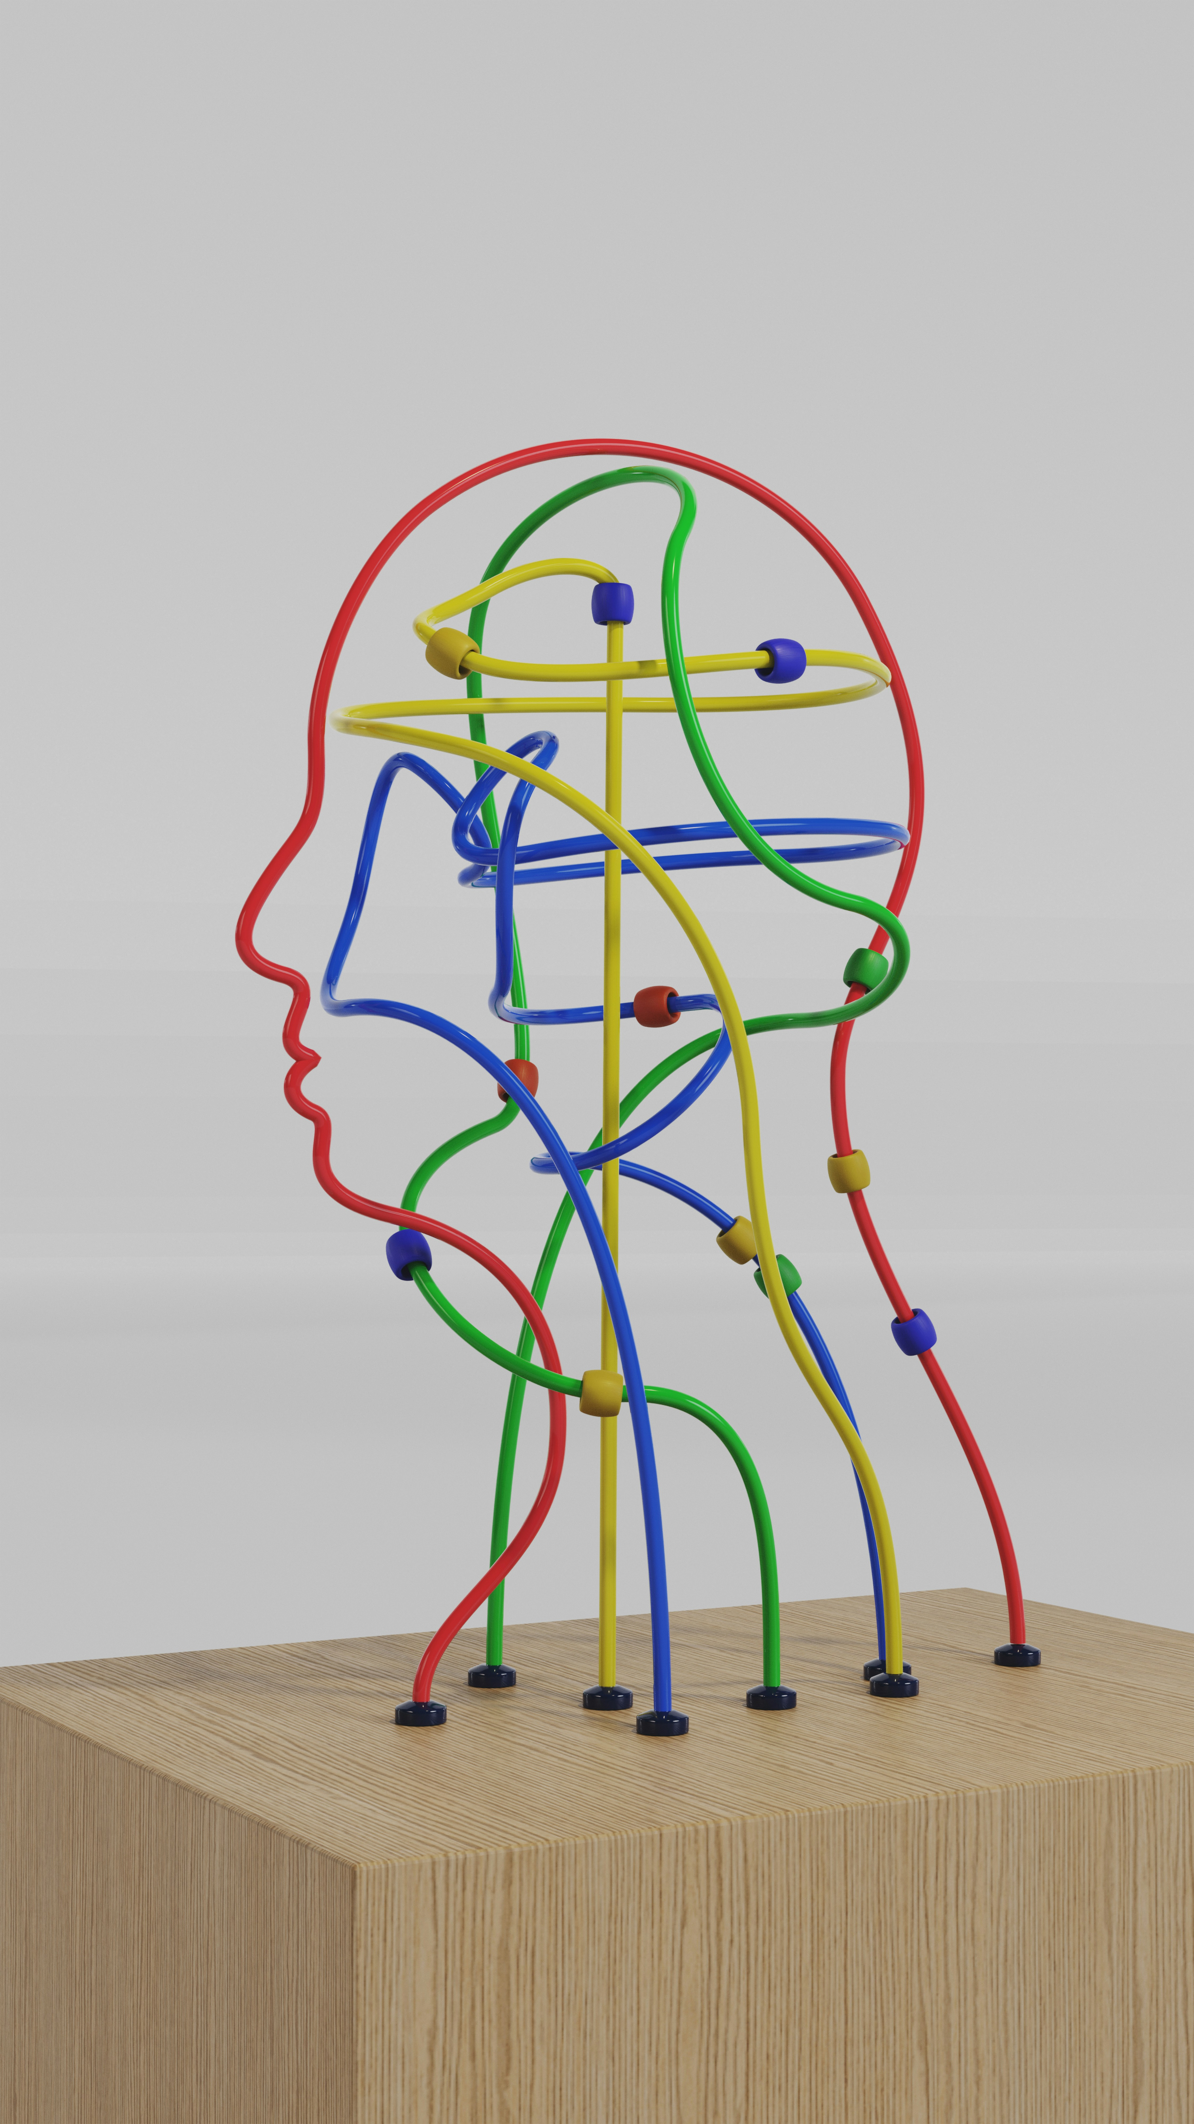
PSY7142 Understanding Humans Through Data

Slide 2
Module outline
Week 1: Introducing data, introducing Rstudio
Week 2: Manipulating data, using Rstudio
Week 3: Exploring data and creating figures and graphs, using Rstudio
Week 4: Categorical data and the chi-squared test – testing random versus structured?
Week 5: t-tests – testing whether two groups are different
Week 6: Research report/analysis
Week 7: Measurement, hypotheses, associations (correlations)
Week 8: Predicting behaviour: the linear model
Week 9: Data visualisation
Week 10: Predicting behaviour: developing the linear model

Slide 3
Objectives for Week 5
By the end of this session, you should be able to:
Understand when t-tests are appropriately applied to data
Understand the distinction between paired and independent t-tests
Interpret p-values from t-tests
Determine how a paired t-test is calculated
Determine how an independent t-test is calculated
Understand effect sizes for t-tests
Be able to effectively interpret t-test results
Be able to accurately present t-test results in research reports

Slide 4

An example
A researcher is interested in investigating whether the eye contact between a baby and his/her mother changes over time.
The researcher observes a group of eight babies interacting with their mothers.
The frequency of eye contact is recorded when the babies are aged 6 and 9 months.
The researcher now wishes to determine whether or not there is a statistically significant difference between the means of the two sets of scores .
Notes:
So, is this a paired or an independent t-test?

Slide 5
Data (frequency of eye contact)
Baby | 6 months | 9 months
A | 3 | 7
B | 5 | 6
C | 5 | 3
D | 4 | 8
E | 3 | 5
F | 7 | 9
G | 8 | 7
H | 7 | 9
We are interested in the differences between these scores
The t-test measures the distribution of the differences between these scores

Slide 6
Calculating the paired t-test: Step 1
Step 1
Calculate the difference scores (D) between the two conditions/time points.
Baby | 6 months | 9 months | D
A | 3 | 7 | -4
B | 5 | 6 | -1
C | 5 | 3 | 2
D | 4 | 8 | -4
E | 3 | 5 | -2
F | 7 | 9 | -2
G | 8 | 7 | 1
H | 7 | 9 | -2

Slide 7



Calculating the paired t-test: Step 2
Step 2
Calculate the sums and means for each columns
Baby | 6 months | 9 months | D
A | 3 | 7 | -4
B | 5 | 6 | -1
C | 5 | 3 | 2
D | 4 | 8 | -4
E | 3 | 5 | -2
F | 7 | 9 | -2
G | 8 | 7 | 1
H | 7 | 9 | -2
Sums | ΣX₁=42 | ΣX₂=54 | ΣD=-12
Means | =5.25 | =6.75 | =-1.5

Slide 8
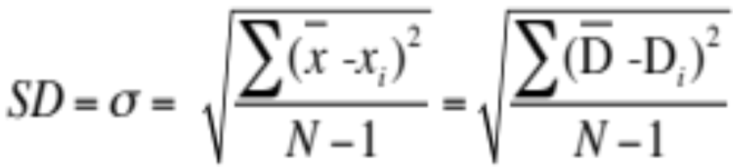
Calculating the paired t-test: Step 3
Step 3
Calculate the standard deviation (SD or σ) for the differences
Remember that

Slide 9
Calculating the paired t-test: Step 3 ctd
Step 3
Calculate the standard deviation of these difference scores
Baby | D | D-D | (D-D)²
A | -4 | 2.5 | 6.25
B | -1 | -0.5 | 0.25
C | 2 | -3.5 | 12.25
D | -4 | 2.5 | 6.25
E | -2 | 0.5 | 0.25
F | -2 | 0.5 | 0.25
G | 1 | -2.5 | 6.25
H | -2 | 0.5 | 0.25
Sums | ΣD=-12 |  | Σ(D-D)²=32
Means | =-1.5

Slide 10
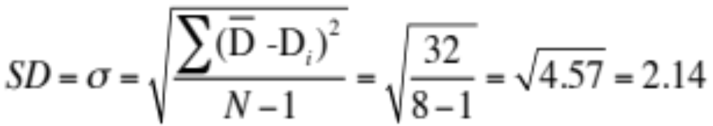
Calculating the paired t-test: Step 3 ctd
Step 3
Calculate the standard deviation (SD or σ) for the difference distribution, this is also known as the Standard Deviation of the Means of Difference Scores.
Remember that

Slide 11
Calculating the paired t-test: Step 3 ctd
Step 3
We now have mean and standard deviation of the differences
We could now get the z-score by dividing the mean by the standard deviation
The t-test value is similar but we divide the mean by the standard error

Slide 12
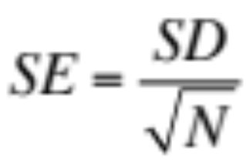
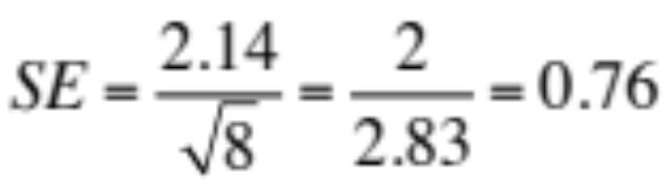
Calculating the paired t-test: Step 4
Step 4
Calculate the standard error (SE) of the Means of Difference Scores using the following formula:
(Where N is sample size)

Slide 13
Calculating the paired t-test: Step 4 ctd
Step 4
As the size of the sample increases, the standard error decreases, which means the t-test value gets bigger
  As sample increases, our confidence in the sample representing the whole population increases

Slide 14
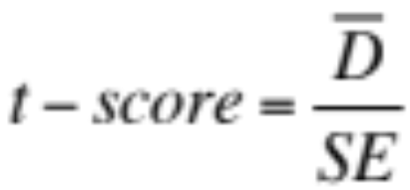
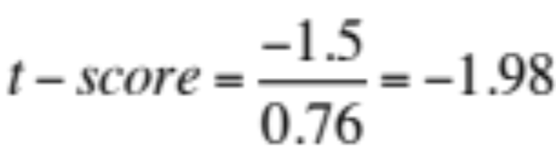
Calculating the paired t-test: Step 5
Step 5
Calculate the t-test score using the following formula:

Slide 15
Calculate df and p: Step 6
Step 6
Degrees of freedom (df) are a measure of the number of ways a set of data is free to vary. This is related to the number of scores in the data set.
  In the case of paired t-tests
    → df= n-1
In our example, because we have 8 subjects, df=8-1=7.
With the t-test score and the df, we can work out the p-value
  in the example, p = .088

Slide 16
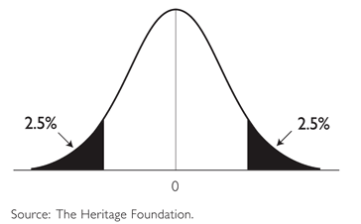
t-test scores and p-values: Step 6 ctd
Step 6
So, here we fail to reject the null hypothesis
  → No evidence for a difference between babies’ scores at six and nine months
-1.98
-2.36
2.36

Slide 17
Reporting the data from a paired t-test
Eye contact was numerically higher at nine months (M = 6.75, SD = 2.05) than at six months (M = 5.25, SD = 1.91). However, this difference was not significant, t(7) = −1.98, p = .088, and so we could not determine whether the amount of eye contact differs between six months and nine months of age.
... But ideally we also include the effect size … see later …

Slide 18
t-test for independent scores
The independent t-test compares the means of two sets of scores from two separate groups of individuals to see whether the means differ significantly under the two conditions.

Slide 19
Independent T-Test
Used when different subjects are being tested on different conditions
    Boys and girls
    Morning class and Afternoon class
    Psychology majors and Chemistry majors

Slide 20
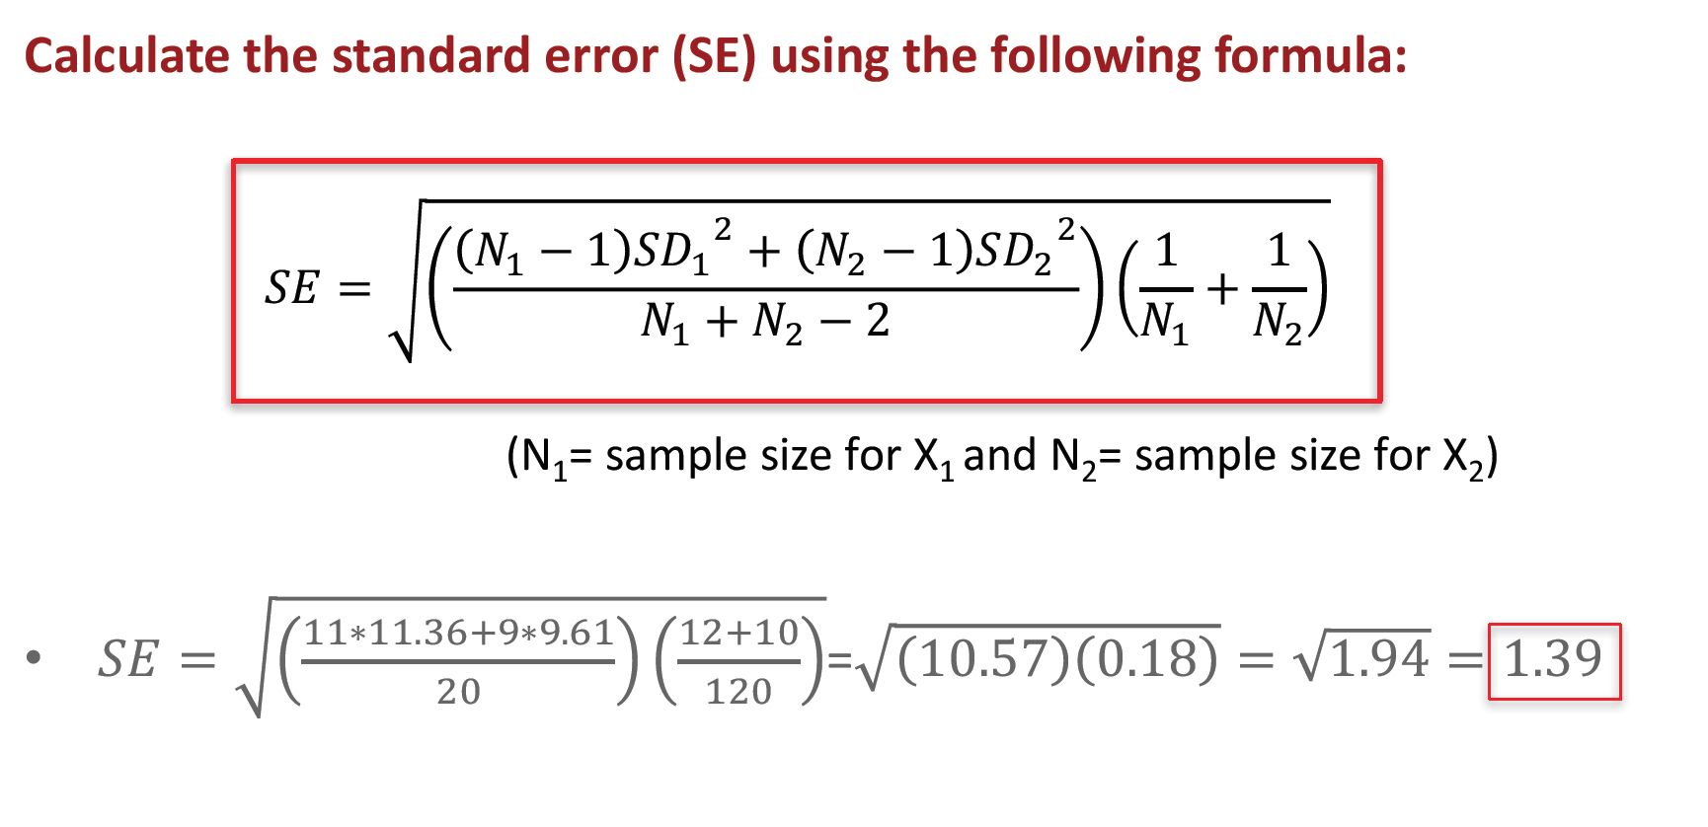
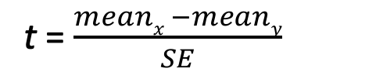
Independent T-Test
t = $\frac{meanx −meany}{SE}$
SE calculated from combining the standard deviation of each group, instead of standard deviation of the differences
df is N-2

Slide 21
Example of an Independent T-Test
A researcher collects the emotionality scores from two groups of children.
  Group 1 = children from two-parent families
  Group 2 = children from lone-parent families
The researcher therefore uses an independent t-test to examine whether or not there is a statistically significant difference between the means of these two sets of scores

Slide 22
Emotionality Scores
Two-Parent |  | Lone-Parent
12 | 18 | 6 | 9
14 | 10 | 4 | 13
19 | 8 | 14 | 9
15 | 11 | 8 | 12
10 | 13 | 11 | 9
15 | 16
MEAN = 13.42 |  | MEAN = 9.50

Slide 23
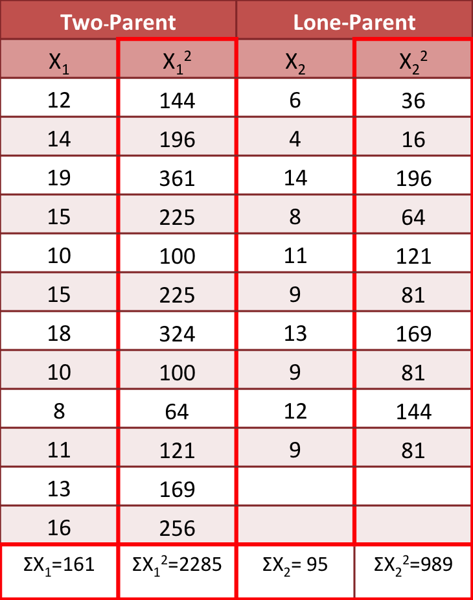
Calculating independent t-score: Step 1
Step 1
Extend the data table by adding columns of squared scores and columns of totals.
ΣX₁= sum of scores for two-parent family sample
ΣX₁²= sum of squared scores for two-parent family sample
ΣX₂= sum of scores for single-parent family sample
ΣX₂²= sum of squared scores for single-parent family sample

Slide 24


Calculating independent t-score: Step 2
Step 2
Find the mean for each sample.
In this example:
∑
X
161
12
X =
1
=
= 13.41
1
N
1
X = ^{∑X2} = ⁹⁵ =
9.50
2
N 10
2

Slide 25
Calculating independent t-score: Step 3
Step 3
Find the standard deviation for each sample.
In this example:
𝑆𝐷₁= 3.37
𝑆𝐷₂= 3.10

Slide 26
Calculating independent t-score: Step 4
Step 4

Slide 27
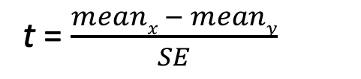
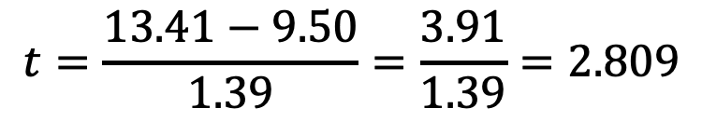
Calculating independent t-score: Step 5
Step 5
Compute the t-score
In this example:
t = $\frac{meanx − meany}{SE}$
$$t=\frac{13.41−9.50}{1.39}=\frac{3.91}{1.39}=2.809$$

Slide 28
Calculating effect size
Statistical significance (i.e., p < .05) does not mean our effect is important in practical terms. To discover whether the effect is substantive, we must measure the effect size.
As t-test values vary according to the number of participants, we can’t know from the t-test alone what the relative size of the effect is
So, we use Cohen’s d, which gives us a measure of the size of the effect in standard deviation units in terms of the differences between groups
  E.g., if Cohen’s d = 1, that means there is one standard deviation of difference between the groups
  If Cohen’s d = 0.5, that means there is 0.5 standard deviations of difference between the groups

Slide 29
Calculating effect size: demo
See this excellent demo for interpreting different values for Cohen’s d in terms of differences between two distributions of data: https://rpsychologist.com/d3/cohend/

Slide 30
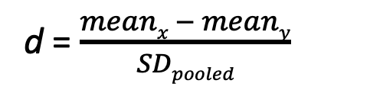
Calculating and interpreting effect sizes
d = $\frac{meanx − meany}{SDpooled}$
… R can work it out for you
In our example, d = 1.208
Cohen (1988, 1992) has made some widely used suggestions about what constitutes a large or small effect:
  d = 0.1 (small effect)
  d = 0.3 (medium effect)
  d = 0.5 (large effect)

Slide 31
Interpreting t-test results
We found that significantly greater emotionality scores were observed in children from two-parent (M = 13.41, SD = 3.37) than one-parent (M = 9.50, SD = 3.10) families, t(20) = 2.81, p = .011, d = 1.21, a large effect size.

Slide 32
Reporting the data from a paired t-test (now including d value)
Eye contact was numerically higher at nine months (M = 6.75, SD = 2.05) than at six months (M = 5.25, SD = 1.91). However, this difference was not significant, t(7) = −1.98, p = .088, d = .70, and so we could not determine whether the amount of eye contact differs between six months and nine months of age.

Slide 33
Summary
t-test tells us about the differences between two groups
  And our confidence in the difference (p-value)
Measures from the same participants, different conditions:
  paired t-test
Measures from different participants, different conditions:
  independent t-test
Effect sizes tell us about the size of the difference
How to interpret and report t-test results

